Slide 1
AI-Powered Chatbot for learning ML Concepts
Under the guidance of Mr.S. Naresh Kumar
Assistant Professor, Department of CSE

Slide 2
TEAM MEMBERS:
D.MANICHANDRA - 2203A51L96
S.SANDEEEP - 2203A51L86
SD.RAHMAN - 2203A51L58
E.MANISH - 2203A51L80

Slide 3
ABSTRACT:
This project involves building a chatbot using Python and machine learning concepts. The chatbot will be designed to understand natural language and provide relevant responses to user input.
The machine learning algorithms used in the chatbot will be trained on a large dataset of human conversations to enable it to generate more realistic responses.

Slide 4
INTRODUCTION:
A chatbot is an automated conversational agent that can communicate with users through text or speech. Python is a popular programming language used for building chatbots, and machine learning concepts can be applied to enhance their performance.

Slide 5
PROBLEM STATEMENT:
A problem statement for a chatbot with Python using machine learning concepts would be to develop an intelligent conversational agent that can understand natural language and provide accurate and relevant responses to user queries. This chatbot should be able to handle a wide range of topics and understand context and intent to provide helpful and meaningful answers to user questions.

Slide 6
OBJECTIVES:
Natural Language Processing: One of the main objectives of a chatbot is to understand and respond to natural language input from the user. Machine learning algorithms such as Recurrent Neural Networks (RNNs) and Sequence-to-Sequence models can be used to train the chatbot to understand and generate natural language responses.
Intent Recognition: The chatbot should be able to recognize the user's intent behind their input and respond accordingly. This can be achieved using techniques such as Supervised Learning, where the chatbot is trained on labeled data to recognize specific intents.

Slide 7
ACHITECTURE:
The question and answer chatbot for machine learning concepts will be built using a natural language processing (NLP) architecture.
The chatbot will be trained on a large dataset of machine learning concepts and questions written in simple human language. The NLP model will be designed to understand and interpret natural language questions and provide accurate responses

Slide 8
LITERATURE SURVEY:
"Building a Simple Chatbot from Scratch in Python (using NLTK)," by Parul Pandey (2019) - This tutorial explains how to build a chatbot using Python and the Natural Language Toolkit (NLTK).
"Creating a Chatbot with Deep Learning, Python, and TensorFlow," by Keras (2021) - This tutorial provides an overview of how to create a chatbot using deep learning, Python, and TensorFlow.

Slide 9
DATA PRE-PROCESSING:
Text Cleaning: The first step in data pre-processing for a chatbot is to clean the text data. This involves removing unnecessary characters, punctuation, and white space from the input text. It can be done using Python's string manipulation functions.
Stemming or Lemmatization: Stemming or lemmatization is the process of reducing words to their base form. This can help reduce the number of unique words in the data and improve the accuracy of the chatbot's responses. Stemming and lemmatization can be done using Python's NLTK library.

Slide 10
ABOUT CHATBOT WITH PYTHON USING ML ANALYSIS:
Data Collection: Collecting a large and diverse dataset of conversations between humans and chatbots to use as the training data.
Data Preprocessing: Preprocessing the collected data by cleaning, filtering, and transforming it into a format that can be used for analysis. This may involve removing duplicate entries, filling in missing data, and normalizing data.
Feature Extraction: Extracting relevant features from the preprocessed data. These features may include user input, chatbot response, sentiment analysis, intent detection, and named entity recognition.
Algorithm Selection: Selecting appropriate ML algorithms that can effectively process and analyze the extracted features.

Slide 11
ABOUT DATASET:
1. Intents: it is a name of the dictionary we used json dataset file.
2. Tag: tag used to identify an individual key in our dataset. Here in our dataset key is particular type of questions.
3. Patterns : patterns are used to identify different types of questions.
4. Responses : response is the answer given to the patterns.

Slide 12
DATA INSIGHTS
Data Collection: You need to gather the data that the chatbot will use to understand and respond to user queries.
Data Cleaning and Preprocessing: Once you have collected the data, you need to clean and preprocess it to ensure that it is in a format that can be used by machine learning algorithms.
Text Representation: To train a machine learning model, you need to represent text data in a format that can be understood by the model.
Model Training: Once the data is cleaned and preprocessed, you can train a machine learning model on the data.

Slide 13
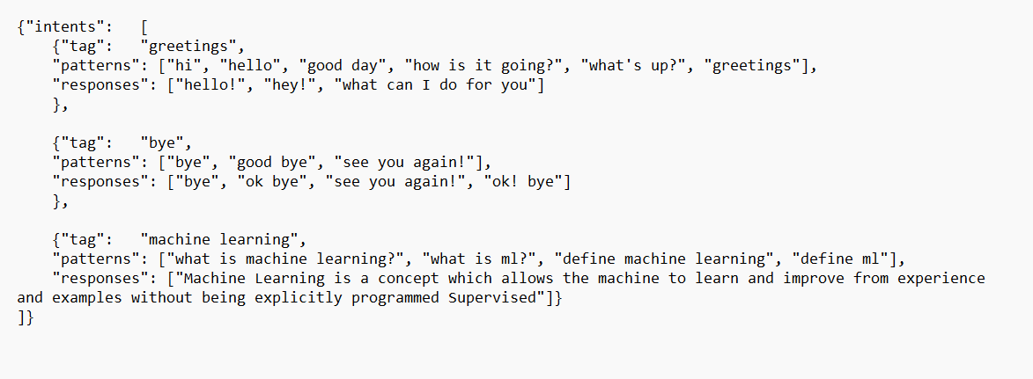
DATA SET:

Slide 14
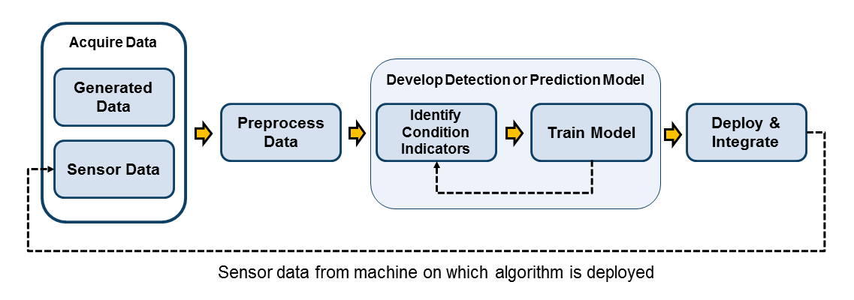
CLEANED DATASET:

Slide 15
CLEANED DATASET:
Data cleaning is the process of identifying and correcting or removing errors and inconsistencies in data.
before training the chatbot, it is important to identify and remove any duplicate data or irrelevant information that could affect the chatbot's accuracy.
This can be done by using various data cleaning techniques such as removing missing values, handling outliers, and normalizing data.

Slide 16
DATA VISUALIZATION:
Data visualization is the representation of data through use of common graphics, such as charts, plots, infographics, and even animations.
These visual displays of information communicate complex data relationships

Slide 17
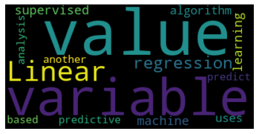
In [15]:
from wordcloud import WordCloud
text = '''Linear regression is a supervised machine learning algorithm
,uses predictive analysis to predict the value of variable based on value of another variable '''
wordcloud = WordCloud().generate(text)
import matplotlib.pyplot as plt
plt.imshow(wordcloud, interpolation='bilinear') plt.axis("off")
plt.show()

Slide 18
METHODOLOGY:
The methodology for solving the problem of building a question and answer chatbot for machine learning concepts involves several steps to ensure that the chatbot is accurate, reliable, and userfriendly.
The first step in the methodology is to define the problem statement and objectives of the chatbot.

Slide 19
CONCLUSION
In conclusion, the question and answer chatbot on machine learning concepts is a useful tool that can provide accurate and timely responses to user queries related to machine learning.
The future scope of the chatbot is vast, as it can be further improved to provide more advanced features such as personalized recommendations, sentiment analysis, and voice recognition.

Slide 20
THANK YOU

